Slide 1
Final Review Guide Pre-Calculus
2020-2021
Semester 1 GP 2

Slide 2
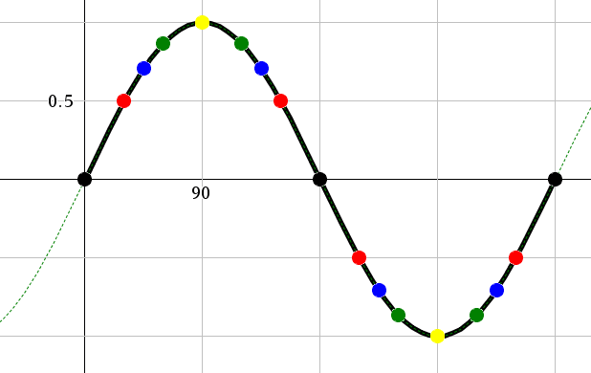
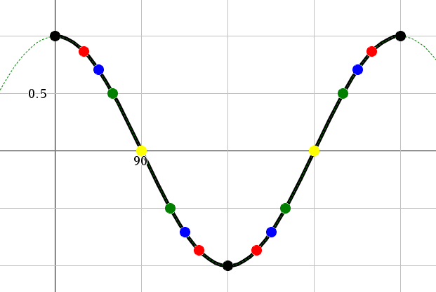
You should know about the Special Values on the Sine Curve and Cosine Curve
You should speak of these special values in terms of both degrees and radians

Slide 3
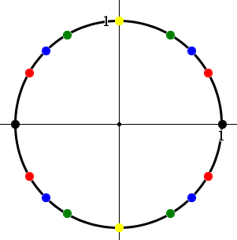
You should know about the Special Values on the Unit Circle
You should speak of these special values in terms of both degrees and radians

Slide 4
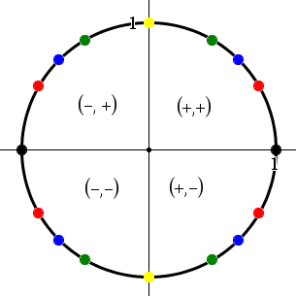
You should be able to use Quadrant 1 Behavior to reference to behavior in the other three quadrants
ALL
sin $θ$ > 0 for all $θ$ in Q1
cos $θ$ > 0 for all $θ$ in Q1
tan $θ$ for all $θ$ in Q1
STUDENTS
sin $θ$ > 0 for all $θ$ in Q2
TAKE
tan $θ$ > 0 for all $θ$ in Q3
CALCULUS
cos $θ$ > 0 for all $θ$ in Q4

Slide 5
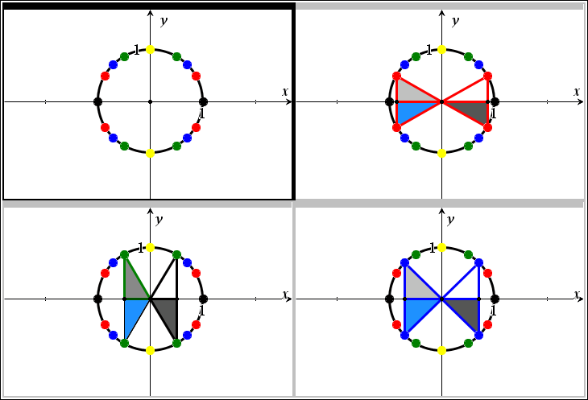
Don’t Forget About the “Bow Ties” when referencing
Remember: Some Bow Ties are “SPECIAL”

Slide 6
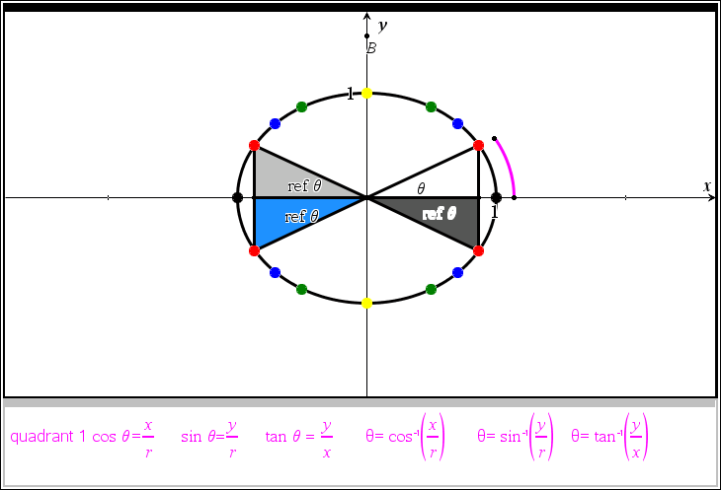
Don’t Forget when referencing NEVER USE THE Y AXIS
Don’t Forget when referencing ALWAYS USE POSITIVE INPUT (calculators don’t reference, people reference)

Slide 7
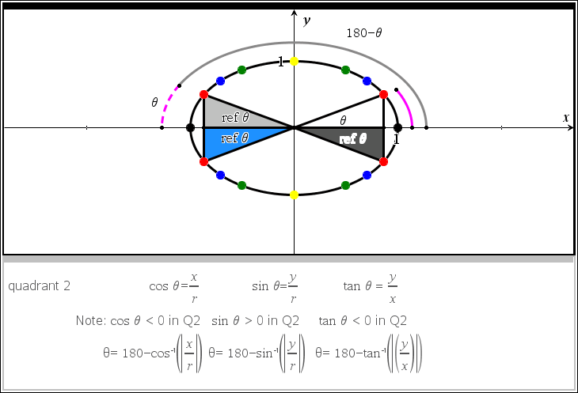
Don’t Forget when referencing NEVER USE THE Y AXIS
Don’t Forget when referencing ALWAYS USE POSITIVE INPUT (calculators don’t reference, people reference)

Slide 8
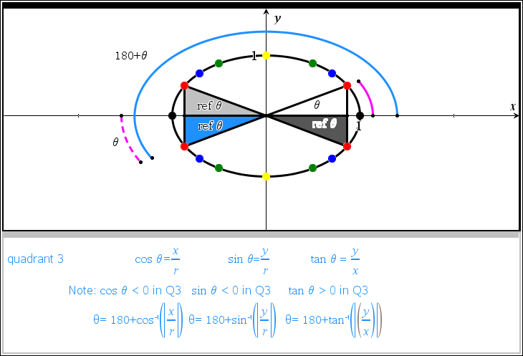
Don’t Forget when referencing NEVER USE THE Y AXIS
Don’t Forget when referencing ALWAYS USE POSITIVE INPUT (calculators don’t reference, people reference)

Slide 9
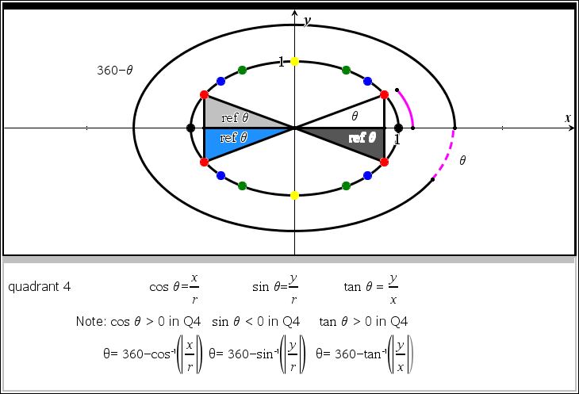
Don’t Forget when referencing NEVER USE THE Y AXIS
Don’t Forget when referencing ALWAYS USE POSITIVE INPUT (calculators don’t reference, people reference)

Slide 10
Don’t Forget when referencing NEVER USE THE Y AXIS
You need to be able to switch from radian to degree and vice versa with your brain and your digital devices

Slide 11
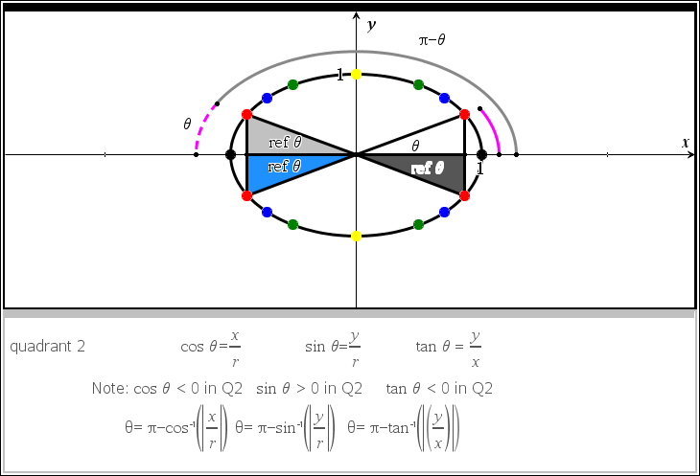
Don’t Forget when referencing NEVER USE THE Y AXIS
You need to be able to switch from radian to degree and vice versa with your brain and your digital devices

Slide 12
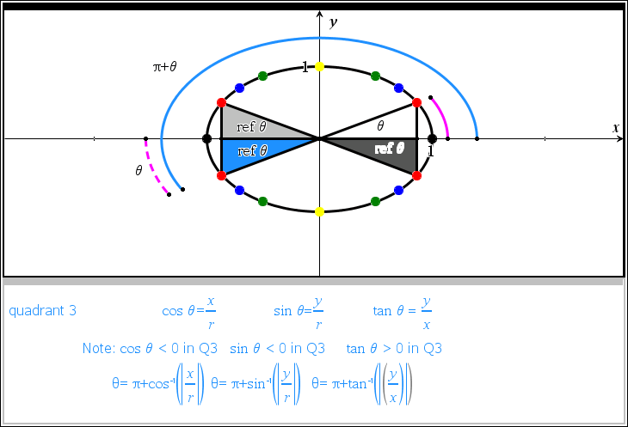
Don’t Forget when referencing NEVER USE THE Y AXIS
You need to be able to switch from radian to degree and vice versa with your brain and your digital devices

Slide 13
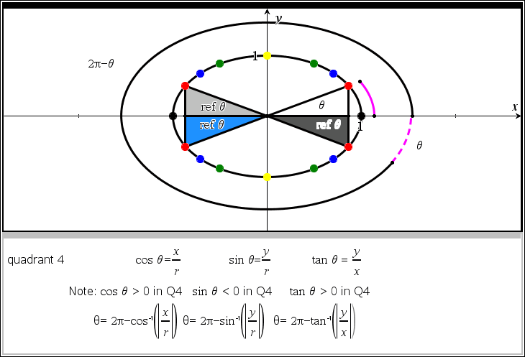
Don’t Forget when referencing NEVER USE THE Y AXIS
You need to be able to switch from radian to degree and vice versa with your brain and your digital devices

Slide 14
You should be able to use referencing and ordinary points in the coordinate plane to determine the angle formed in the standard position & all related six trigonometric ratios with CORRECT SIGNS

Slide 15
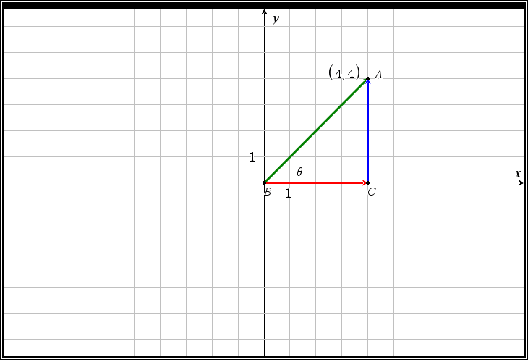
You should be able to use referencing and ordinary points in the coordinate plane to determine the angle formed in the standard position & all related six trigonometric ratios with CORRECT SIGNS
Exact value of $θ$
__________________
Approximate
Value of $θ$
_________________
$$\sin{θ=______}$$
$$\cos{θ=______}$$
$$\tan{θ=______}$$
$$\csc{θ=______}$$
$$\sec{θ=______}$$
$$\cot{θ=______}$$

Slide 16
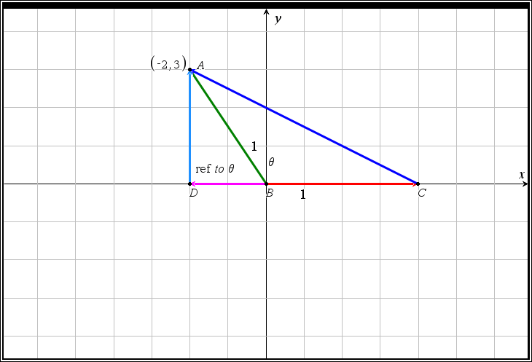
You should be able to use referencing and ordinary points in the coordinate plane to determine the angle formed in the standard position & all related six trigonometric ratios with CORRECT SIGNS
Exact value of $θ$
__________________
Approximate
Value of $θ$
_________________
$$\sin{θ=______}$$
$$\cos{θ=______}$$
$$\tan{θ=______}$$
$$\csc{θ=______}$$
$$\sec{θ=______}$$
$$\cot{θ=______}$$

Slide 17
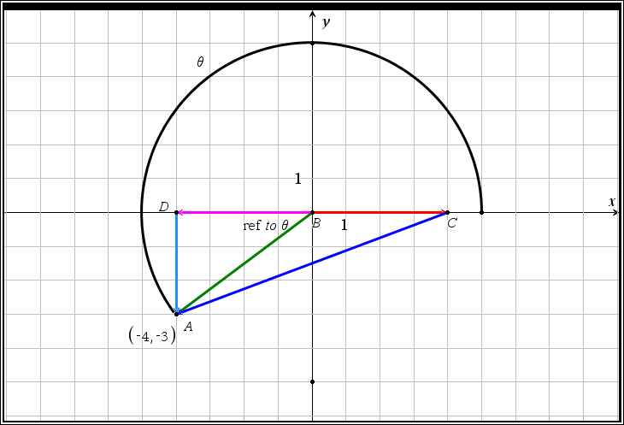
You should be able to use referencing and ordinary points in the coordinate plane to determine the angle formed in the standard position & all related six trigonometric ratios with CORRECT SIGNS
Exact value of $θ$
__________________
Approximate
Value of $θ$
_________________
$$\sin{θ=______}$$
$$\cos{θ=______}$$
$$\tan{θ=______}$$
$$\csc{θ=______}$$
$$\sec{θ=______}$$
$$\cot{θ=______}$$

Slide 18
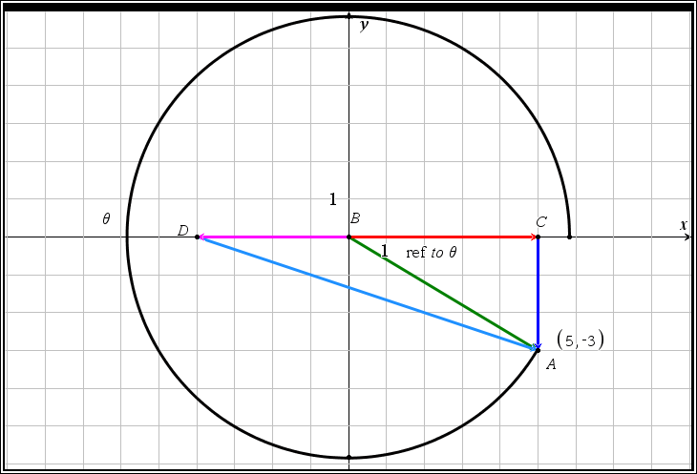
You should be able to use referencing and ordinary points in the coordinate plane to determine the angle formed in the standard position & all related six trigonometric ratios with CORRECT SIGNS
Exact value of $θ$
__________________
Approximate
Value of $θ$
_________________
$$\sin{θ=______}$$
$$\cos{θ=______}$$
$$\tan{θ=______}$$
$$\csc{θ=______}$$
$$\sec{θ=______}$$
$$\cot{θ=______}$$

Slide 19
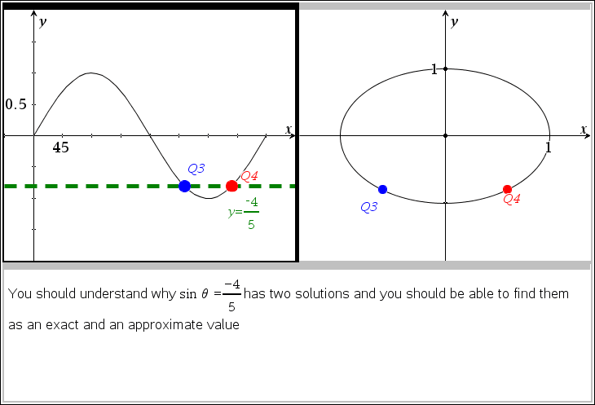

Slide 20
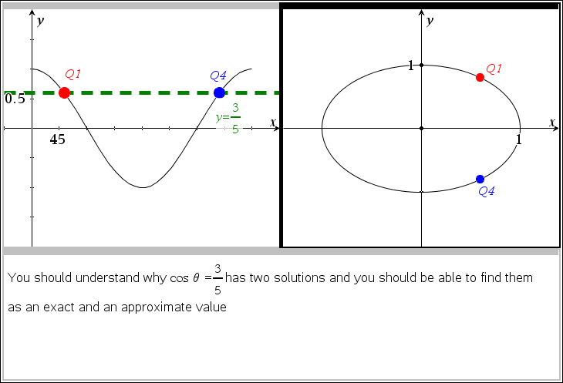

Slide 21
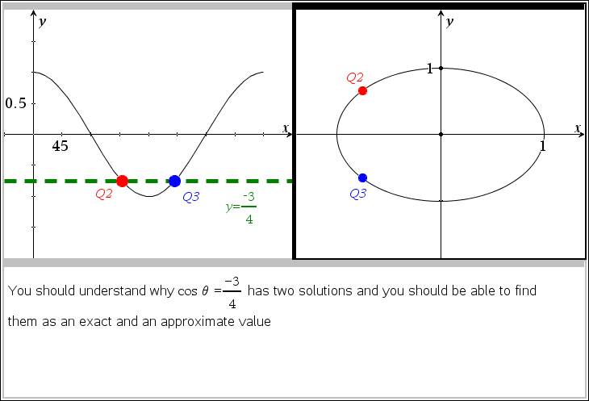

Slide 22
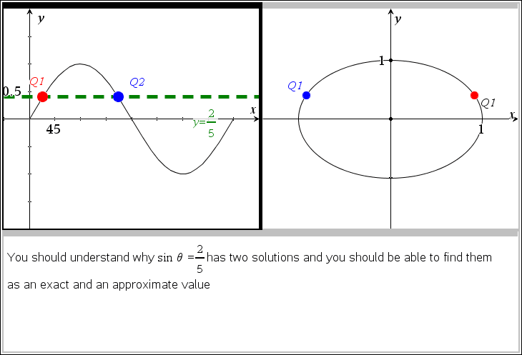

Slide 23
Big Conceptual Goal: Connect the graphs of Sine and Cosine to the Unit Circle
$$(\cos{θ},\sin{θ})$$

Slide 24
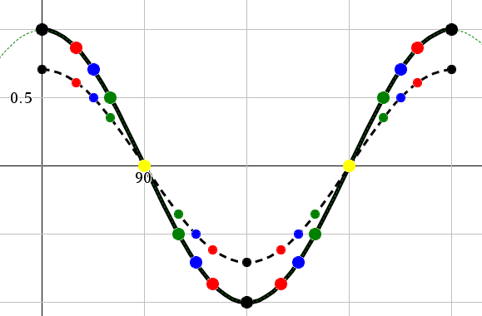
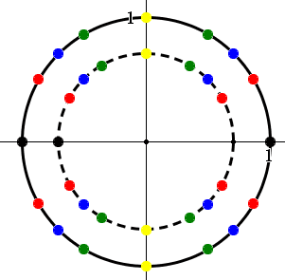
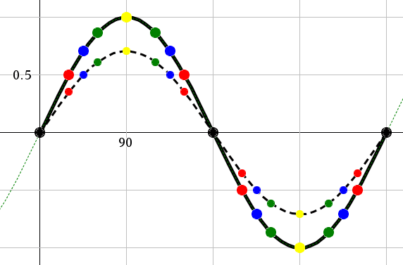
Bigger Conceptual Goal: Connect the vertically compressed graphs of Sine and Cosine to the ANY Circle with 0< radius < 1
$$(\operatorname{rcos}{θ},\operatorname{rsin}{θ})$$

Slide 25
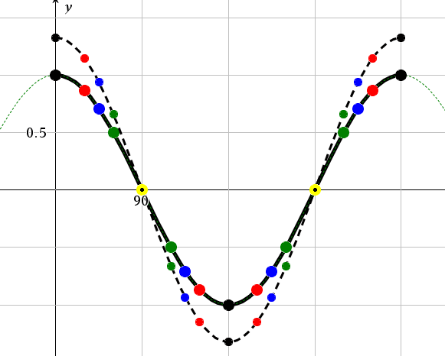
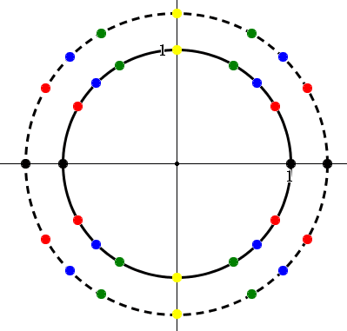
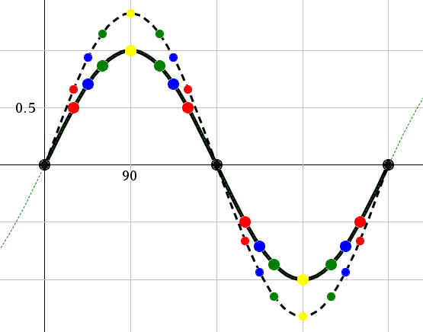
Bigger Conceptual Goal: Connect the vertically stretched graphs of Sine and Cosine to the ANY Circle with radius >1
$$(\operatorname{rcos}{θ},\operatorname{rsin}{θ})$$

Slide 26
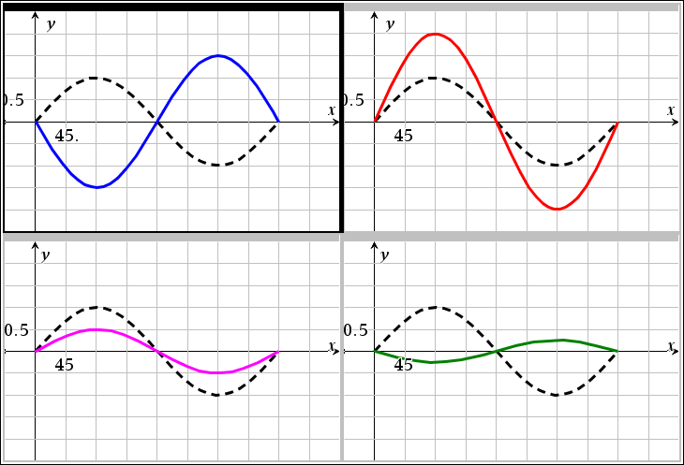
You should be able to graph, describe, and use proper vocabulary related to trigonometric transformations

Slide 27
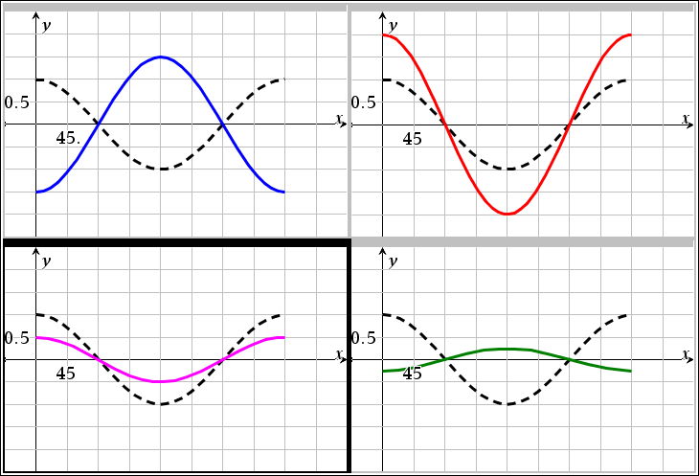
You should be able to graph, describe, and use proper vocabulary related to trigonometric transformations

Slide 28
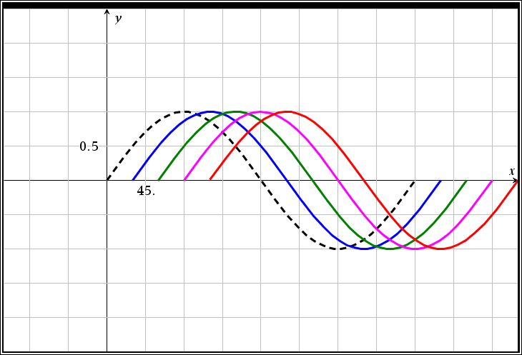
You should be able to graph, describe, and use proper vocabulary related to trigonometric transformations

Slide 29
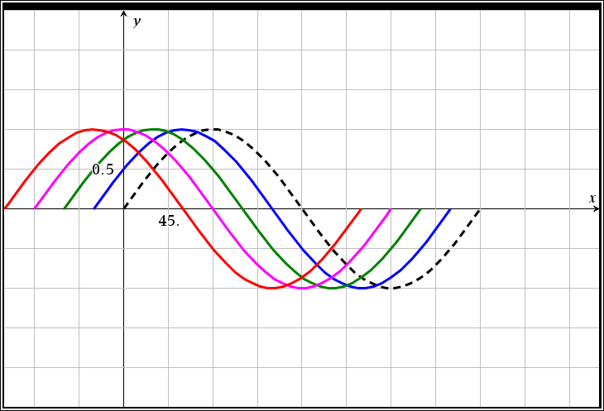
You should be able to graph, describe, and use proper vocabulary related to trigonometric transformations

Slide 30
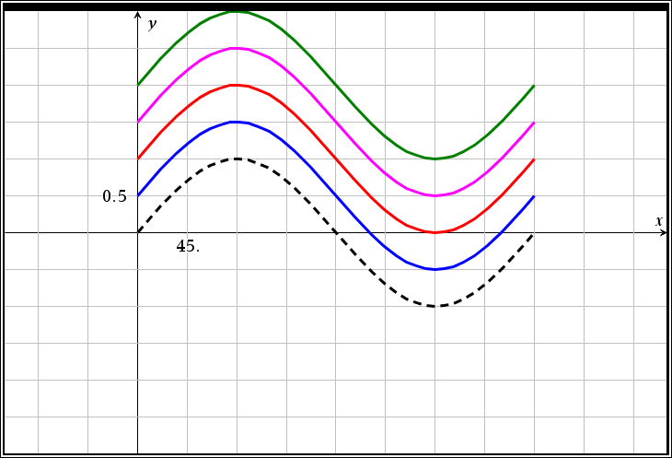
You should be able to graph, describe, and use proper vocabulary related to trigonometric transformations

Slide 31
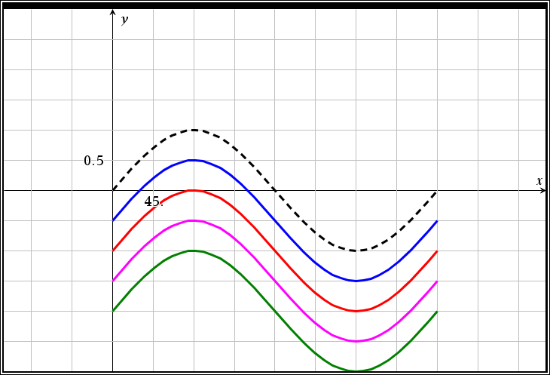
You should be able to graph, describe, and use proper vocabulary related to trigonometric transformations

Slide 32
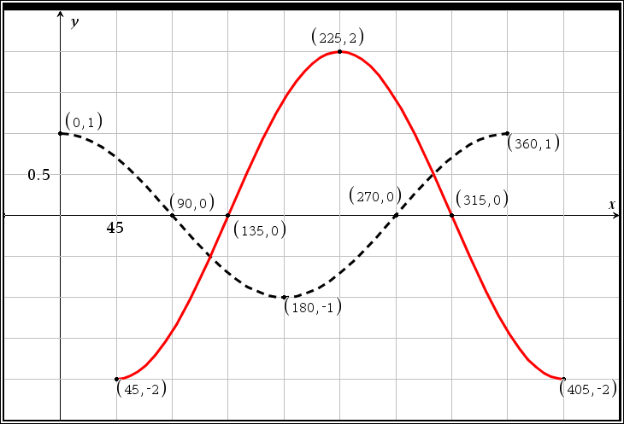
You should be able to discuss and describe the behavior of a trigonometric function based on the parent graph

Slide 33
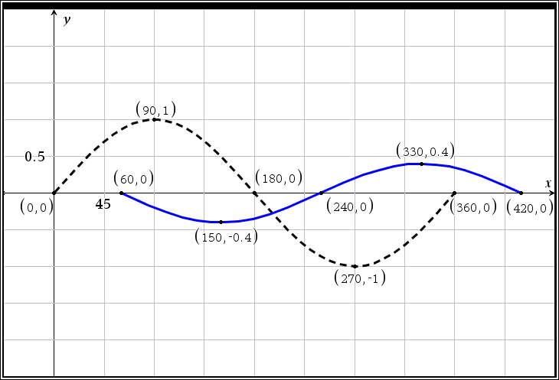
You should be able to discuss and describe the behavior of a trigonometric function based on the parent graph

Slide 34
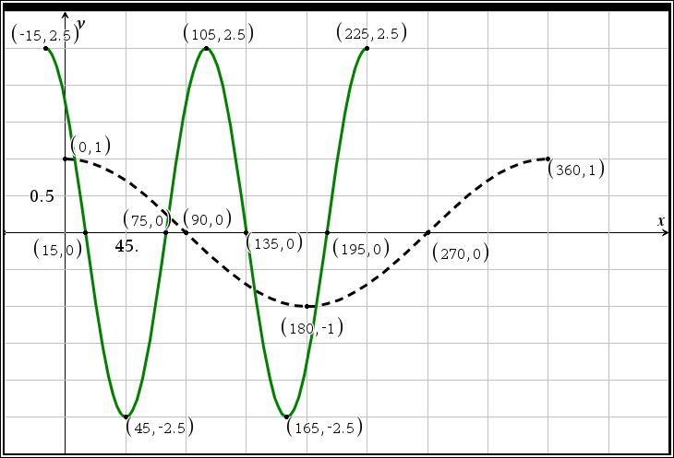
You should be able to discuss and describe the behavior of a trigonometric function based on the parent graph

Slide 35
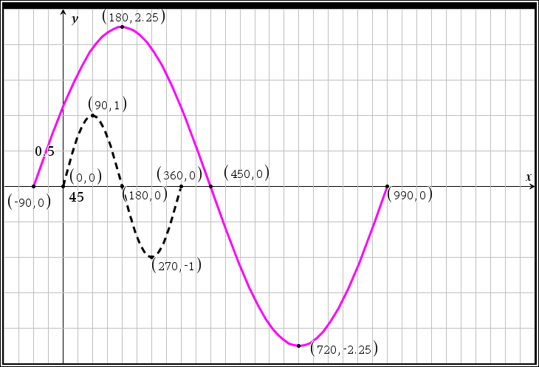
You should be able to discuss and describe the behavior of a trigonometric function based on the parent graph

Slide 36
You should be able to convert a function to the parts of a function and its graph
$$y=10 sin⁡(5x−270)$$
State each of the following
a
b
c
d
Period length
The period implied by transformation (state using proper bracket notation)
The range (state using proper bracket notation)
The amplitude
The phase shift (direction and amount)
State the five most important points on the graph of the function in the implied period
Which of the transformations has occurred?
Vertical Shift
Vertical Compression
Vertical Stretch
Horizontal Shift (PHASE SHIFT)
Horizontal Stretch
Horizontal Compression

Slide 37
You should be able to convert a function to the parts of a function and its graph
$$y=\frac{−2}{3} sin⁡(\frac{5}{2}x−30)$$
State each of the following
a
b
c
d
Period length
The period implied by transformation (state using proper bracket notation)
The range (state using proper bracket notation)
The amplitude
The phase shift (direction and amount)
State the five most important points on the graph of the function in the implied period
Which of the transformations has occurred?
Vertical Shift
Vertical Compression
Vertical Stretch
Horizontal Shift (PHASE SHIFT)
Horizontal Stretch
Horizontal Compression

Slide 38
You should be able to convert a function to the parts of a function and its graph
$$y=−3 cos⁡(\frac{2}{3}\left(x+30\right))$$
State each of the following
a
b
c
d
Period length
The period implied by transformation (state using proper bracket notation)
The range (state using proper bracket notation)
The amplitude
The phase shift (direction and amount)
State the five most important points on the graph of the function in the implied period
Which of the transformations has occurred?
Vertical Shift
Vertical Compression
Vertical Stretch
Horizontal Shift (PHASE SHIFT)
Horizontal Stretch
Horizontal Compression

Slide 39
You should be able to convert a function to the parts of a function and its graph
$$y=−1 cos(\frac{2}{3}x−π)$$
State each of the following
a
b
c
d
Period length
The period implied by transformation (state using proper bracket notation)
The range (state using proper bracket notation)
The amplitude
The phase shift (direction and amount)
State the five most important points on the graph of the function in the implied period
Which of the transformations has occurred?
Vertical Shift
Vertical Compression
Vertical Stretch
Horizontal Shift (PHASE SHIFT)
Horizontal Stretch
Horizontal Compression

Slide 40
You should be able to convert a function to the parts of a function and its graph
$$y=−4 cos\left(10\left(x−\frac{π}{4}\right)\right)+2$$
State each of the following
a
b
c
d
Period length
The period implied by transformation (state using proper bracket notation)
The range (state using proper bracket notation)
The amplitude
The phase shift (direction and amount)
The equation of the midline
State the five most important points on the graph of the function in the implied period
Which of the transformations has occurred?
Vertical Shift
Vertical Compression
Vertical Stretch
Horizontal Shift (PHASE SHIFT)
Horizontal Stretch
Horizontal Compression

Slide 41
You should be able to convert the parts of a function and description of a function to the function and its graph Given: you have a reflection of sine graph with an amplitude of 9 and a period of [$−3π, 2π)$
State the five most important points on the graph of the function in the implied period
Which of the transformations has occurred?
Vertical Shift
Vertical Compression
Vertical Stretch
Horizontal Shift (PHASE SHIFT)
Horizontal Stretch
Horizontal Compression
State each of the following
a
b
c
d
State the function
Period length
The range (state using proper bracket notation)
The amplitude
The phase shift (direction and amount)

Slide 42
You should be able to convert the parts of a function and description of a function to the function and its graph Given: you have a cosine graph with an amplitude of $\frac{2}{5}$ and a period of [$−π, \frac{π}{2})$
State the five most important points on the graph of the function in the implied period
Which of the transformations has occurred?
Vertical Shift
Vertical Compression
Vertical Stretch
Horizontal Shift (PHASE SHIFT)
Horizontal Stretch
Horizontal Compression
State each of the following
a
b
c
d
State the function
Period length
The range (state using proper bracket notation)
The phase shift (direction and amount)

Slide 43
You should be able to convert the parts of a function and description of a function to the function and its graph Given: you have a reflection of sine graph with whose range has been vertically compressed by a factor of ½ and its period has a phase shift of 45 degrees to the right
State the five most important points on the graph of the function in the implied period
Which of the transformations has occurred?
Vertical Shift
Vertical Compression
Vertical Stretch
Horizontal Shift (PHASE SHIFT)
Horizontal Stretch
Horizontal Compression
State each of the following
a
b
c
d
State the function
Period length
The period implied by transformation (state using proper bracket notation)
The range (state using proper bracket notation)
The amplitude

Slide 44
You should be able to convert the parts of a function and description of a function to the function and its graph Given: you have a cosine graph with whose range has been vertically stretched by a factor of 5 and its period that has been stretched by a factor of 8 has a phase shift of $π$ radians to the left
State the five most important points on the graph of the function in the implied period
Which of the transformations has occurred?
Vertical Shift
Vertical Compression
Vertical Stretch
Horizontal Shift (PHASE SHIFT)
Horizontal Stretch
Horizontal Compression
State each of the following
a
b
c
d
State the function
Period length
The period implied by transformation (state using proper bracket notation)
The range (state using proper bracket notation)
The amplitude

